Slide 1
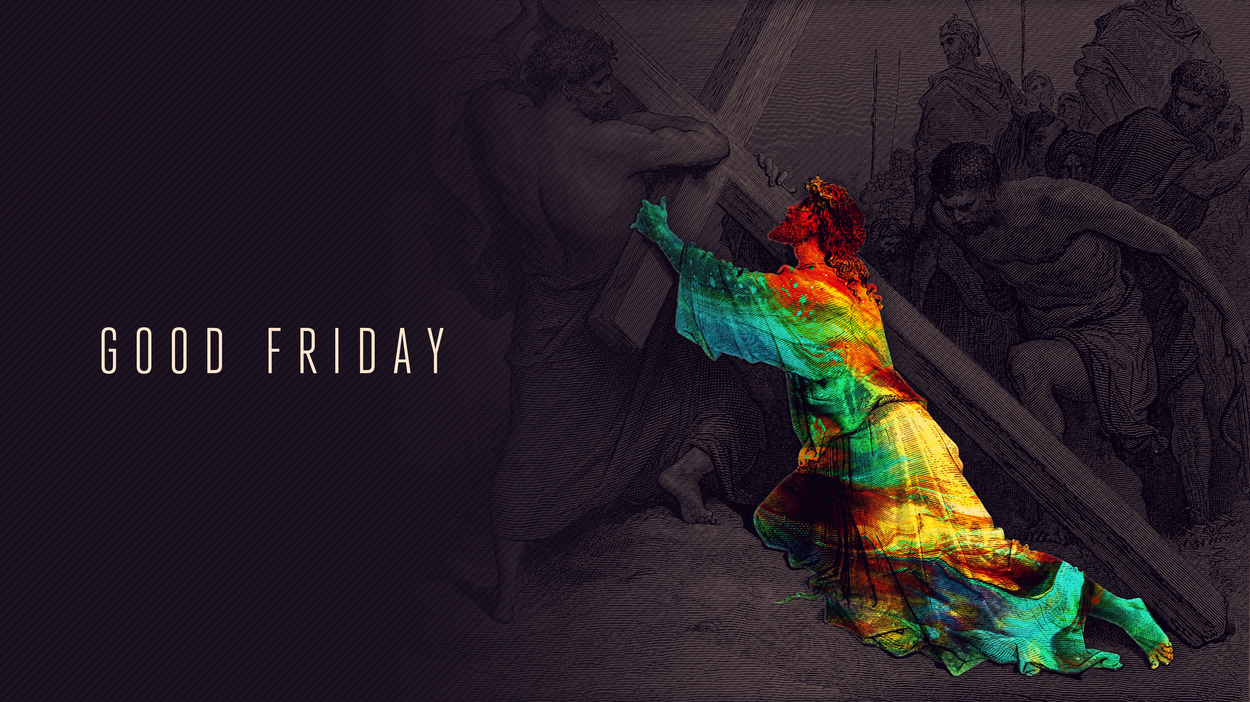

Slide 3
Passover Dayenu
(Adapted)
דַּיֵּנוּ

Slide 4
How many are the abundant blessings which the Almighty has bestowed upon us?
If He had brought us out from Egypt,
and had not carried out judgments against them
it would have been enough!

Slide 5
If He had carried out judgments against them,
and not against their idols
it would have been enough!

Slide 6
If He had destroyed their idols,
and had not smitten their first-born
it would have been enough!

Slide 7
If He had smitten their first-born,
and had not given us their wealth
it would have been enough!

Slide 8
If He had given us their wealth,
and had not split the sea for us
it would have been enough!

Slide 9
If He had split the sea for us,
and had not taken us through it on dry land
it would have been enough!

Slide 10
If He had taken us through the sea on dry land,
and had not drowned our oppressors in it
it would have been enough!

Slide 11
If He had drowned our oppressors in it,
and had not supplied our needs in the desert for forty years
it would have been enough!

Slide 12
If He had supplied our needs in the desert for forty years,
and had not fed us the manna
it would have been enough!

Slide 13
If He had fed us the manna,
and had not given us the Sabbath
it would have been enough!

Slide 14
If He had given us the Sabbath,
and had not brought us before Mount Sinai
it would have been enough!

Slide 15
If He had brought us before Mount Sinai,
and had not given us the Torah
it would have been enough!

Slide 16
If He had given us the Torah,
and had not brought us into the land of Israel
it would have been enough!

Slide 17
If He had brought us into the land of Israel,
and not built for us the Holy Temple
it would have been enough!

Slide 18
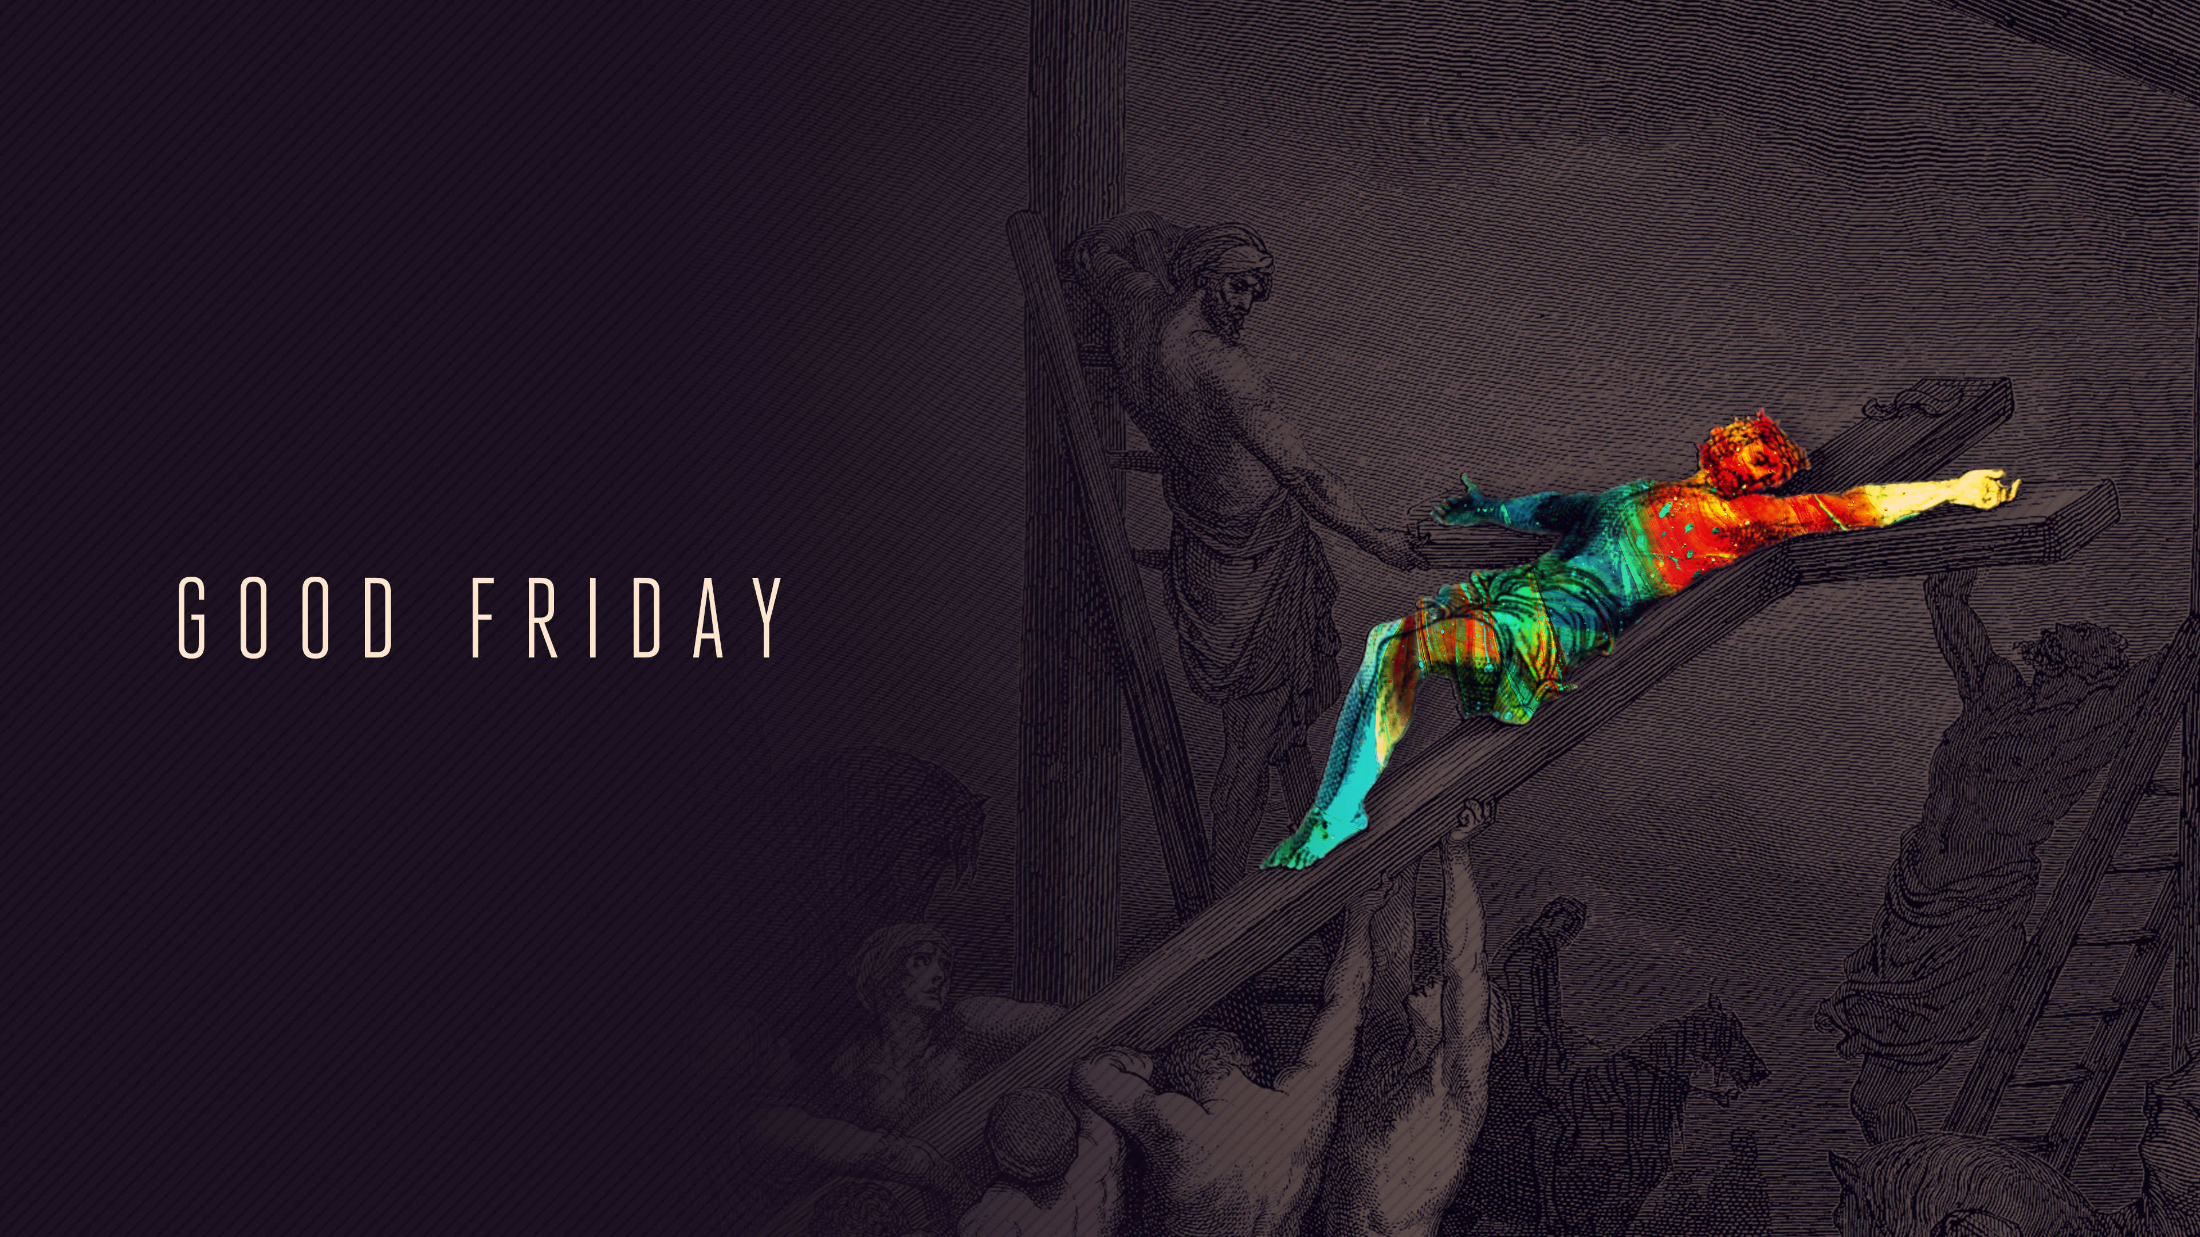

Slide 19
Good Friday Dayenu

Slide 20
How many are the abundant blessings which the Lord Jesus Christ has bestowed upon us?
If He was born of the virgin in a manger,
but wasn’t baptized to identify with humanity
it would have been more than we deserve.

Slide 21
If He was baptized to identify with humanity,
but did not perform miracles and cast out the demonic forces
it would have been more than we deserve.

Slide 22
If He performed miracles and cast out the demonic forces,
but did not speak in parables to reveal the Kingdom of God
it would have been more than we deserve.

Slide 23
If He spoke in parables to reveal the Kingdom of God,
but did not explain the meaning of the parables
it would have been more than we deserve.

Slide 24
If He explained the meaning of the parables,
but did not confront the powerful religious hypocrites
it would have been more than we deserve.

Slide 25
If He confronted the powerful religious hypocrites,
but did not fulfill the Passover in the Lord’s Supper
it would have been more than we deserve.

Slide 26
If He had fulfilled the Passover in the Lord’s Supper,
but he did not endure the scourging under Pontius Pilate
it would have been more than we deserve.

Slide 27
If He endured the scourging under Pontius Pilate,
but He did not endure the cross for the forgiveness of sins
it would have been more than we deserve.

Slide 28
If He endured the cross for the forgiveness of sins,
but was not laid in the tomb of Joseph of Arimathea
it would have been more than we deserve.

Slide 29
If He was laid in the tomb of Joseph of Arimathea,
but was not resurrected from the dead
it would have been more than we deserve.

Slide 30
If He was resurrected from the dead,
but He did not send the Holy Spirit to all His followers
it would have been more than we deserve.

Slide 31
If He sent the Holy Spirit to all His followers,
and will not come again in power and glory
it would have been more than we deserve.

Slide 32
If He comes in power and glory,
but will not prepare a place for us in the Kingdom of Heaven
it will be more than we deserve.

Slide 33
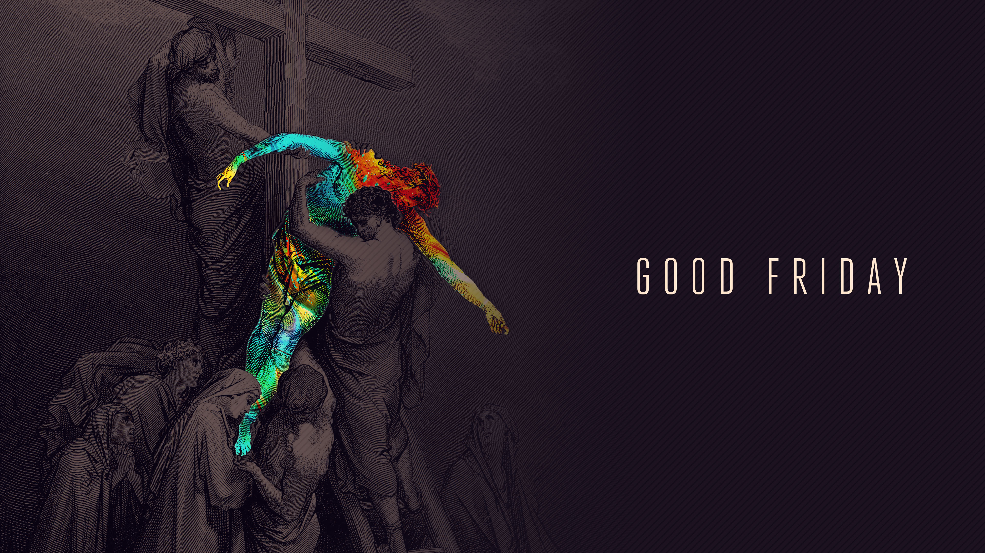

Slide 34
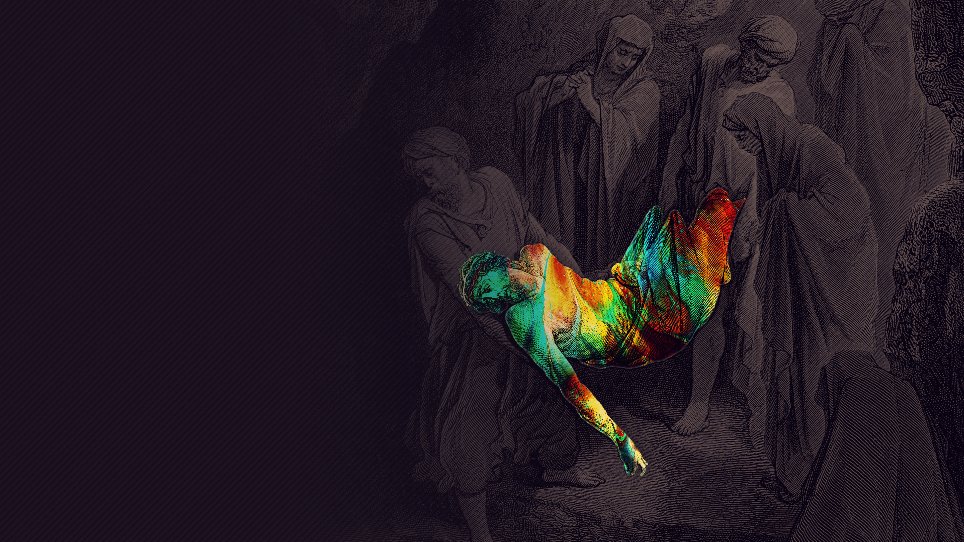
Please depart in the discipline of silence

